Slide 1
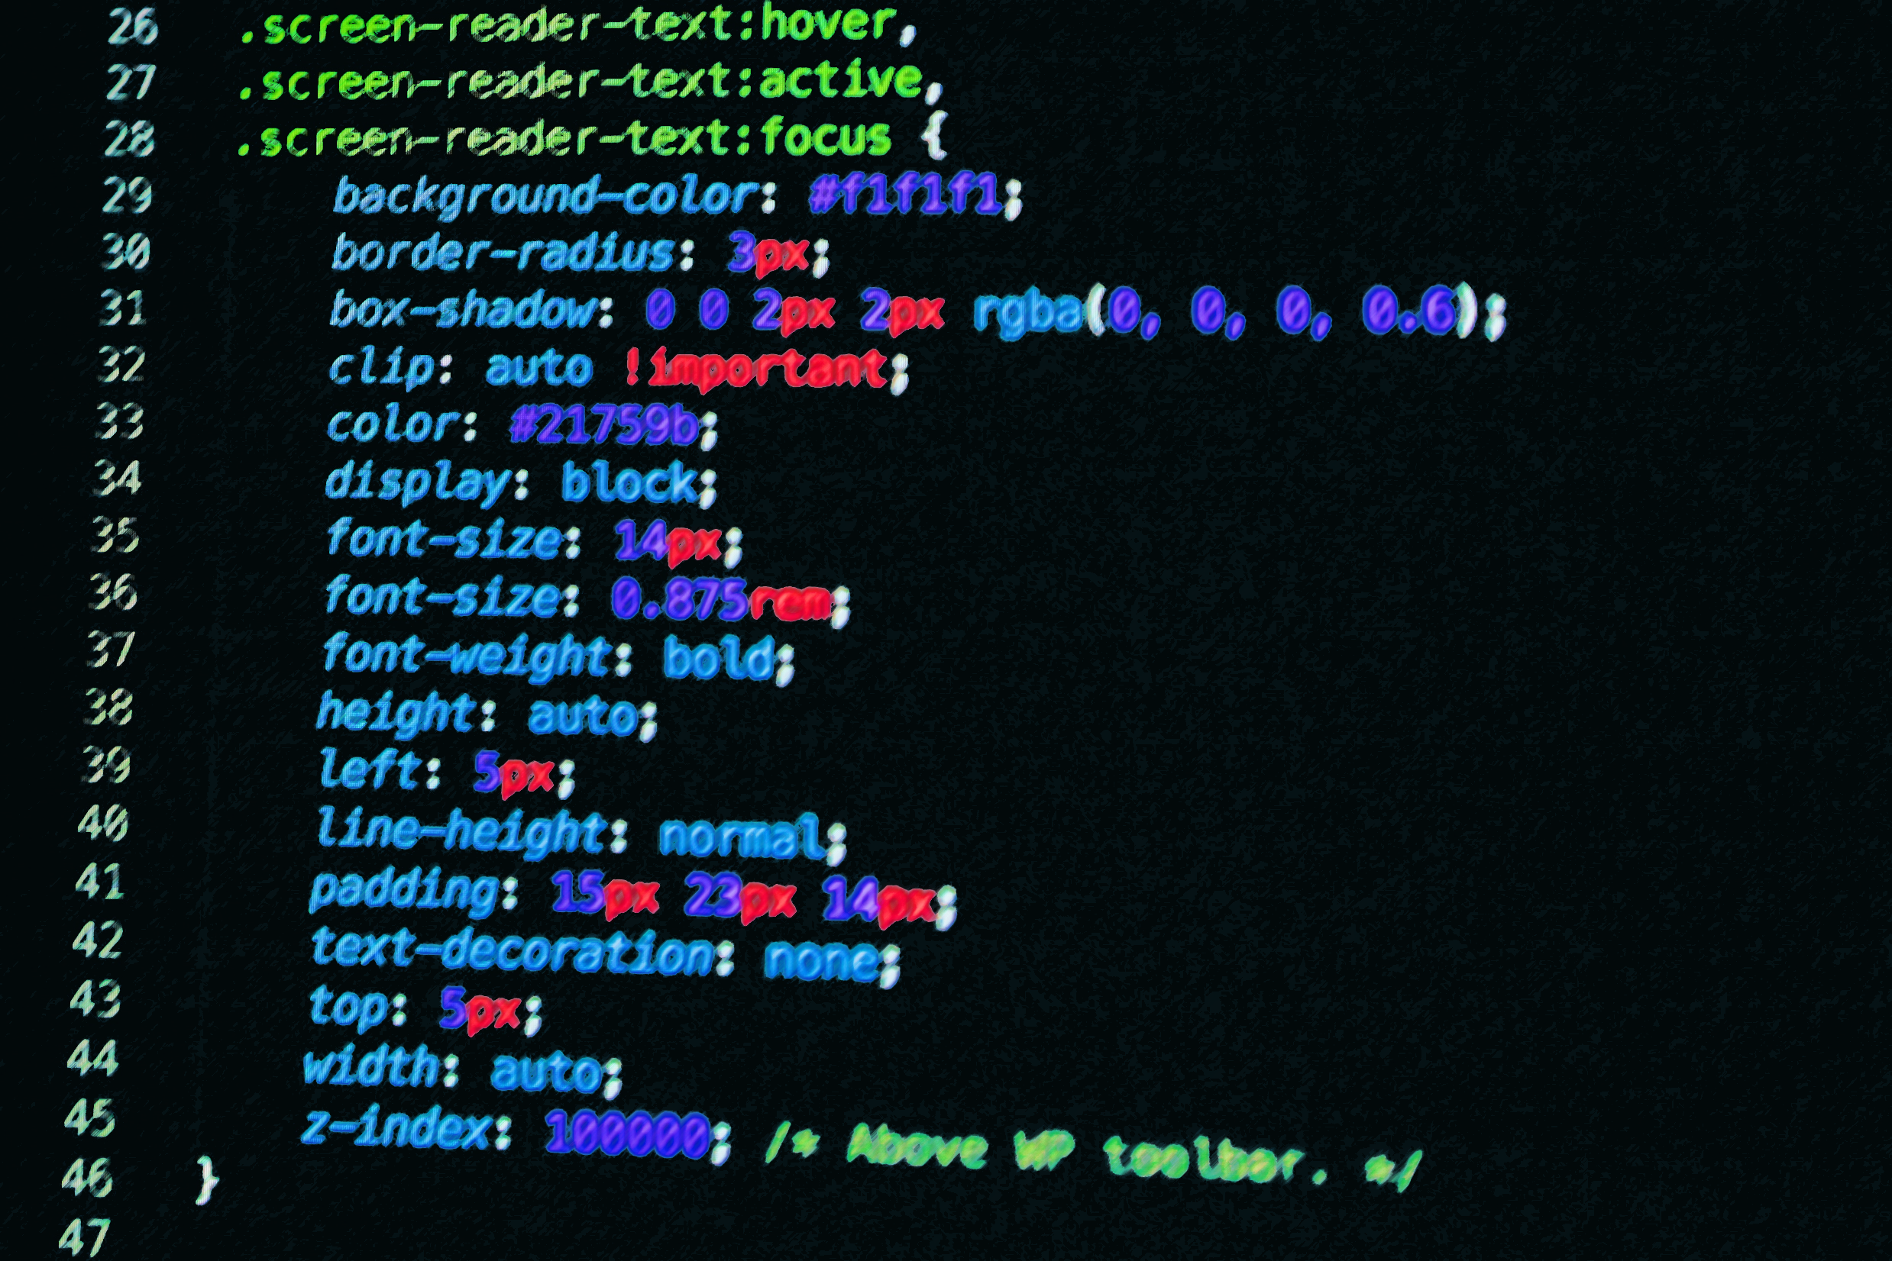
APPLE FAN ECOMMERCE SITE
Aayush Sharma (Giri)
https://github.com/aayushgit/applephp

Slide 2
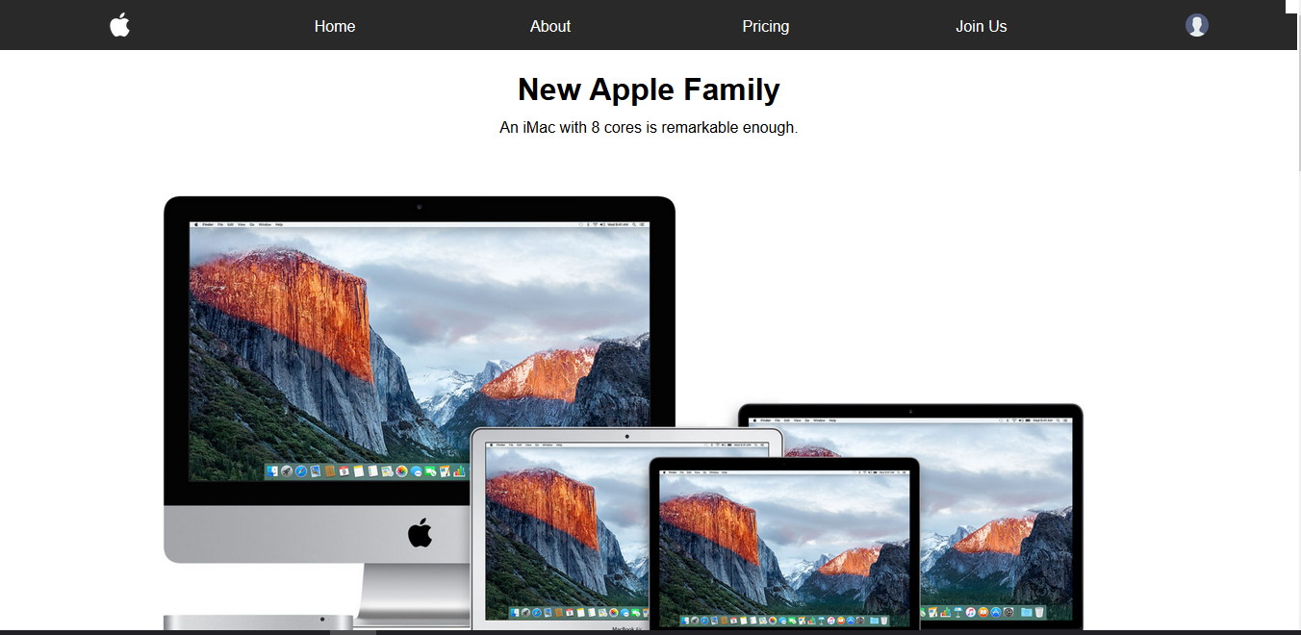
Introduction

Slide 3
Objectives
24/7 Operability
Automated Inventory
Sell Better Quality Products
High Conversions
Customer Satisfaction
Social Popularity

Slide 4
Features
Create Store Visibility
Add/Update Users
Add/Update/Delete Products
Add Customers to Newsletter
Sell Products

Slide 5
Tools Used
WAMP
php
Sublime Text
Unsplash
GitHub

Slide 6

Thank You!

